Slide 1
Homo Florens
Proposal for a New Economic Anthropology for a Sustainable Society
SDG Living Lab
Steven C. van den Heuvel & Cees Tulp
Hogeschool Windesheim, 23 January 2023

Slide 2
The Importance of Reflection on Anthropology in Economics (and beyond)
Altruism often decreases under students of economics, as a result of their studies
This is partly due with the (implicit) anthropology on which this field is based: the homo economicus
See for example: Long Wang, Deepak Malhotra, and J. Keith Murnighan, “Economics Education and Greed,” Academy of Management Learning & Education 10, no. 4 (2011): 643–660.

Slide 3
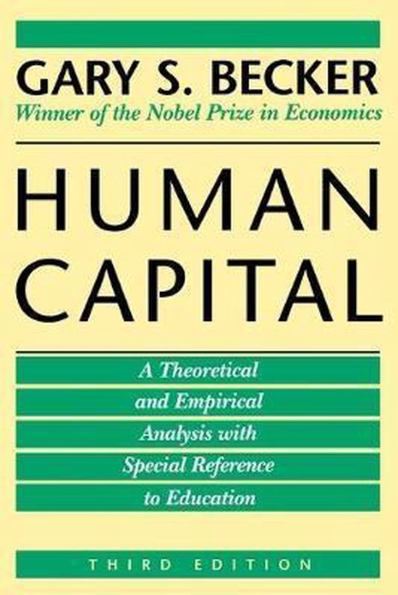
Homo Economicus: A Successful Model
Homo economicus: “a being who desires wealth, and who is capable of judging the comparative efficacy of means for obtaining that end” (John Stuart Mill)
Contemporary example: Gary S. Becker

Slide 4
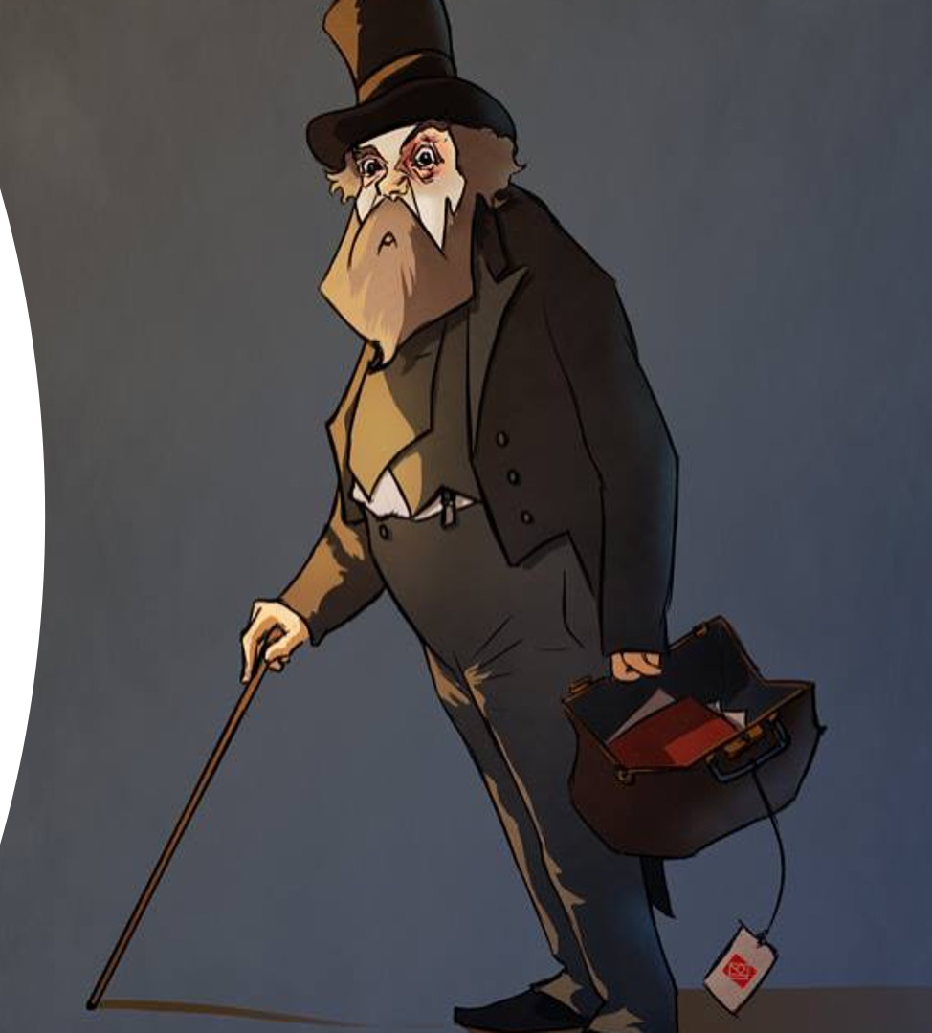
Criticisms Regarding the Homo Economicus
“We have Paleolithic emotions, medieval institutions and godlike technology.” (E. O. Wilson)
Maynard Keynes: “The Markets are moved by animal spirits, and not by reason”
Keynes, The General Theory of Employment, Interest, and Money (1936), 161.

Slide 5
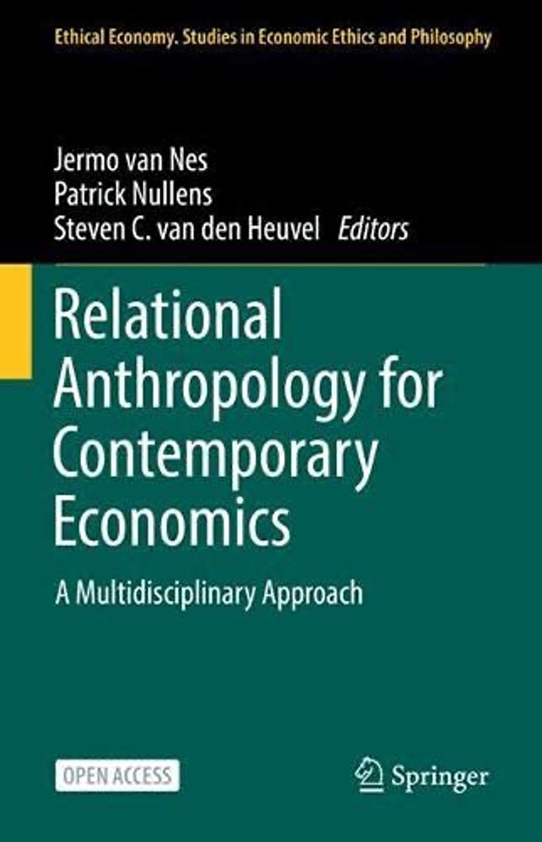
Our Proposal: Broadening (Economic) Anthropology
The Homo Florens
Dialogue with the disciplines 1) philosophy, 2) psychology, 3) theology, and 4) economics
Valorization towards concrete practices

Slide 6
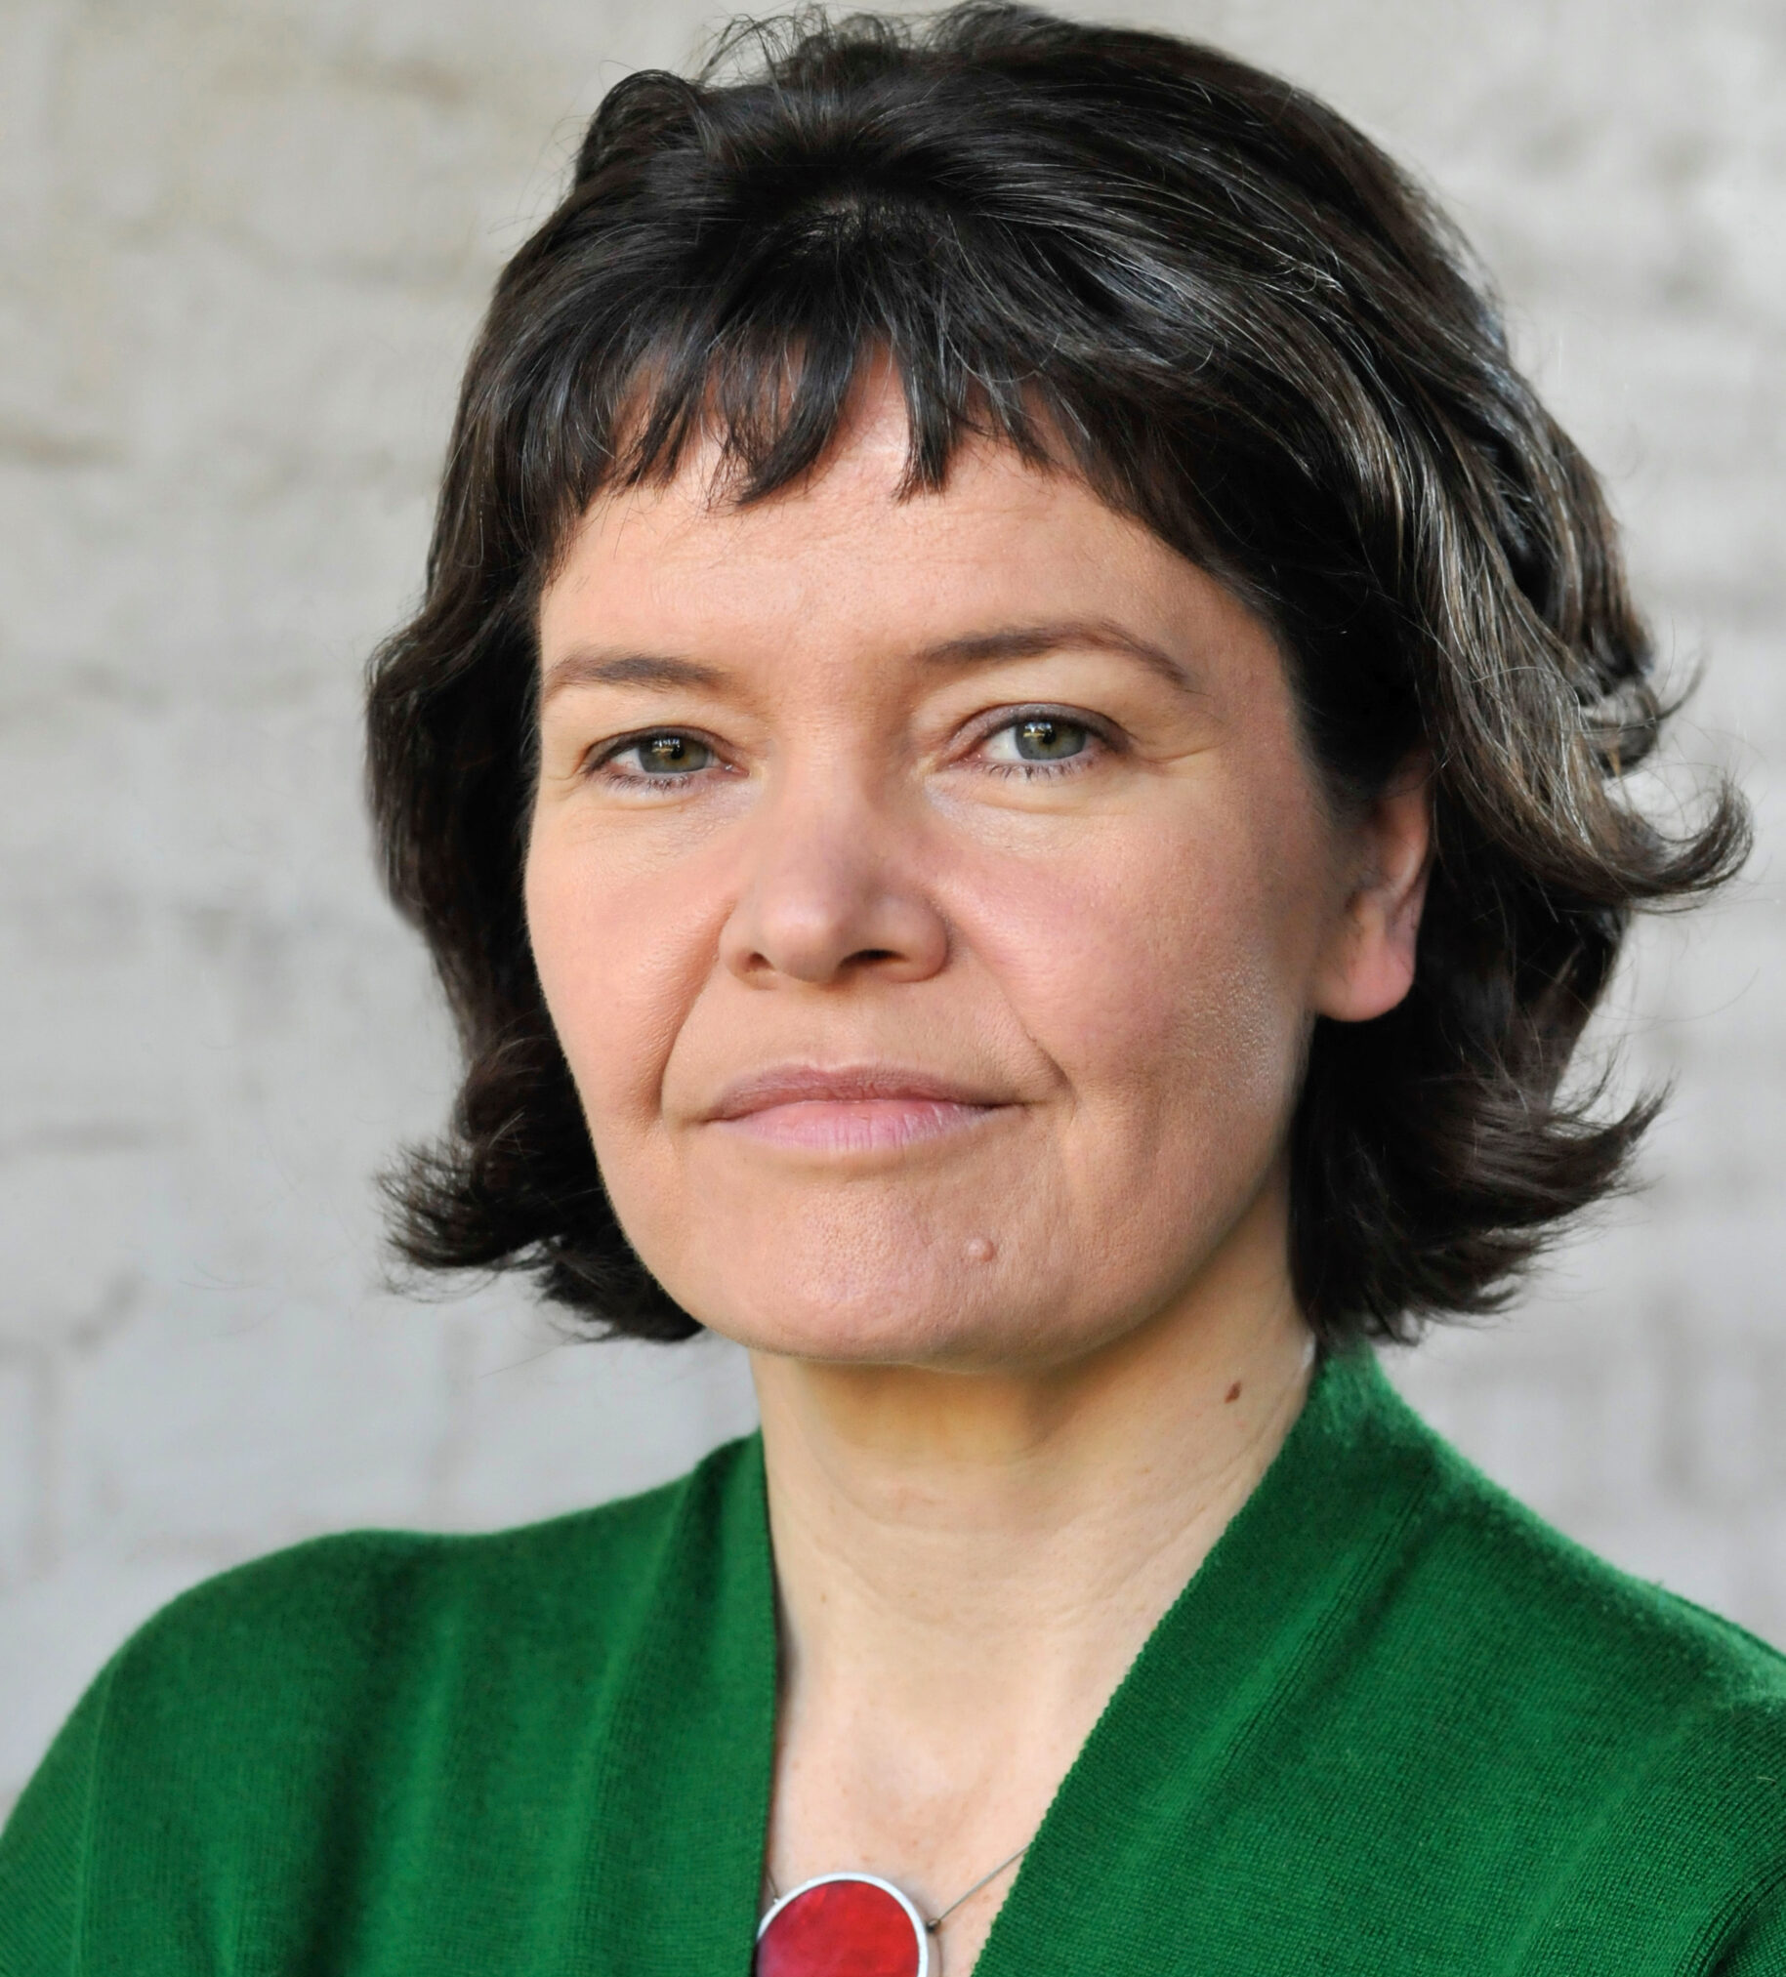
The Importance of a Renewed Anthropology
Kate Raworth
“…it is time to meet ourselves all over again by taking his [Mill’s] cartoon depiction out of the economic gallery and painting, in its place, a new portrait of humanity. It will turn out to be the most important portrait commissioned in the twenty-first century, mattering not just to economists but to us all. Its preparatory sketches are under way and […] many artists are collaborating in piecing them together, from psychologists, behavioral scientists and neurologists to sociologists, political scientists and, yes, economists.”
(Kate Raworth, Doughnut Economics)

Slide 7
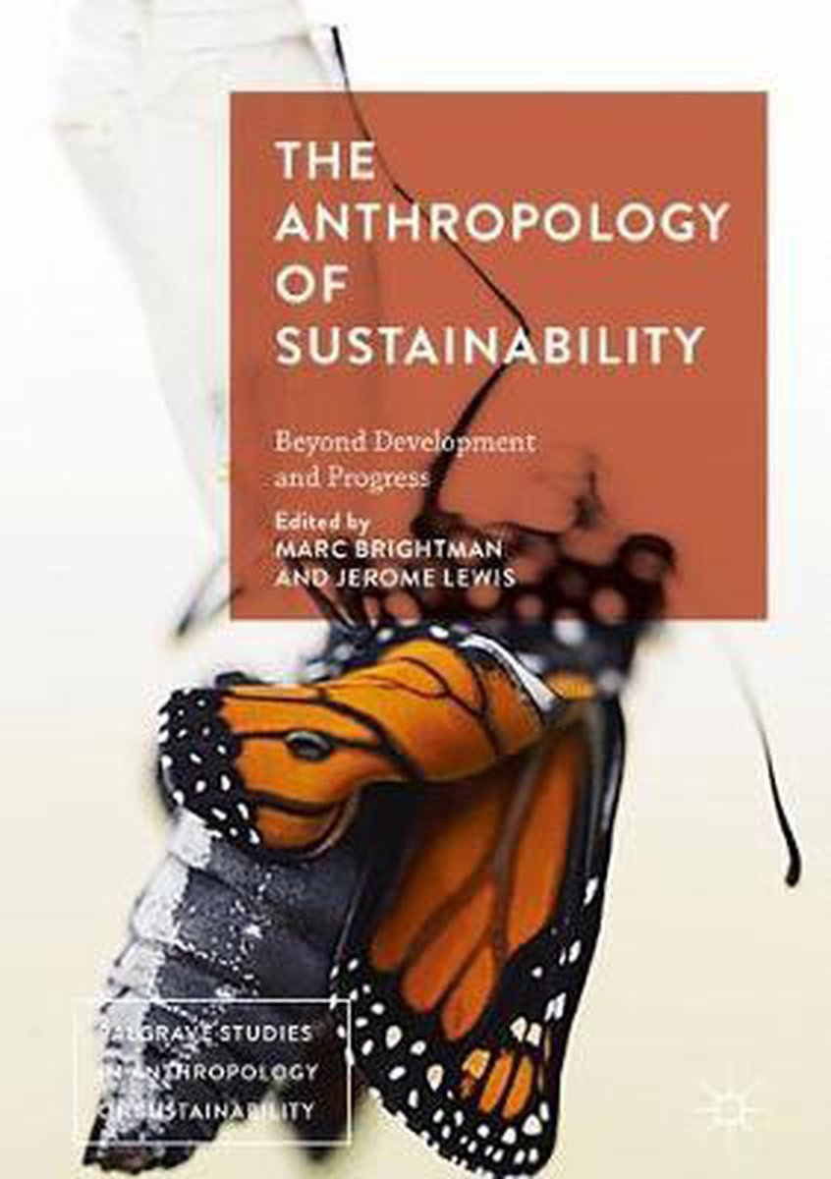
Anthropology in the Sustainability Discourse
The focus on sustainability, specifically on the SDG’s, requires an anthropology
This becomes explicit in the ‘capability approach’ of Sen/Nussbaum, for example

Slide 8
Starting point for the Homo Florens

Slide 9
Humans as Expecting, Questing and Relating Beings
Questing as ‘backward-looking virtue’ → identity
Expecting as ‘forward-looking virtue’ → innovism
Relating as ‘a commitment of the will to the true good of the other’ → attachment
Source: Deirdre McCloskey, The Bourgeois Virtues (2006)

Slide 10
An Operationalization: The Four Drives
Connects with interdisciplinary research into human drives:
Drive to Defend (survival) ← expecting
Drive to Acquire (mastery) ← expecting
Drive to Bond (attachment) ← relating
Drive to Comprehend (meaning) ← questing
Bronnen:
Michael Pirson, Humanistic Management
Anthony Scioli & Henri Biller, Hope in the Age of Anxiety

Slide 11
Focus on the Four Drives in the Context of Sustainability
Again: the four drives
Survival
Mastery
Attachment
Meaning
Anthony Scioli and Henri B. Biller, Hope in the Age of Anxiety (Oxford: Oxford University Press, 2009).

Slide 12
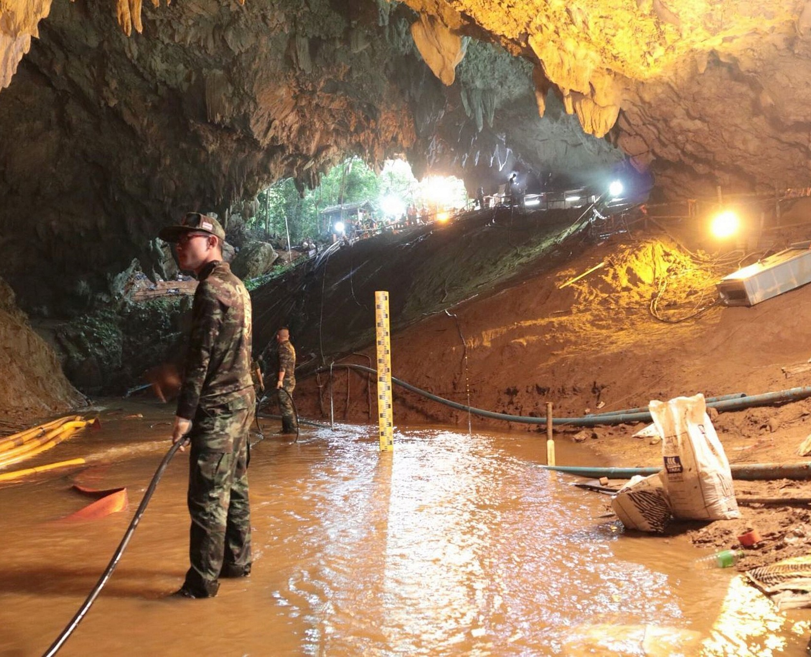
Drive 1: Survival
This dimension “. . . includes survival-oriented trust, terror-management capacity, and a sense of symbolic immortality. Together, they provide a way of addressing the great challenges of the human condition: fear, pain, loss, and death.”
Anthony Scioli, et al., “Hope: Its Nature and Measurement,” Psychology of Religion and Spirituality 3, no. 2 (2011): 82.

Slide 13
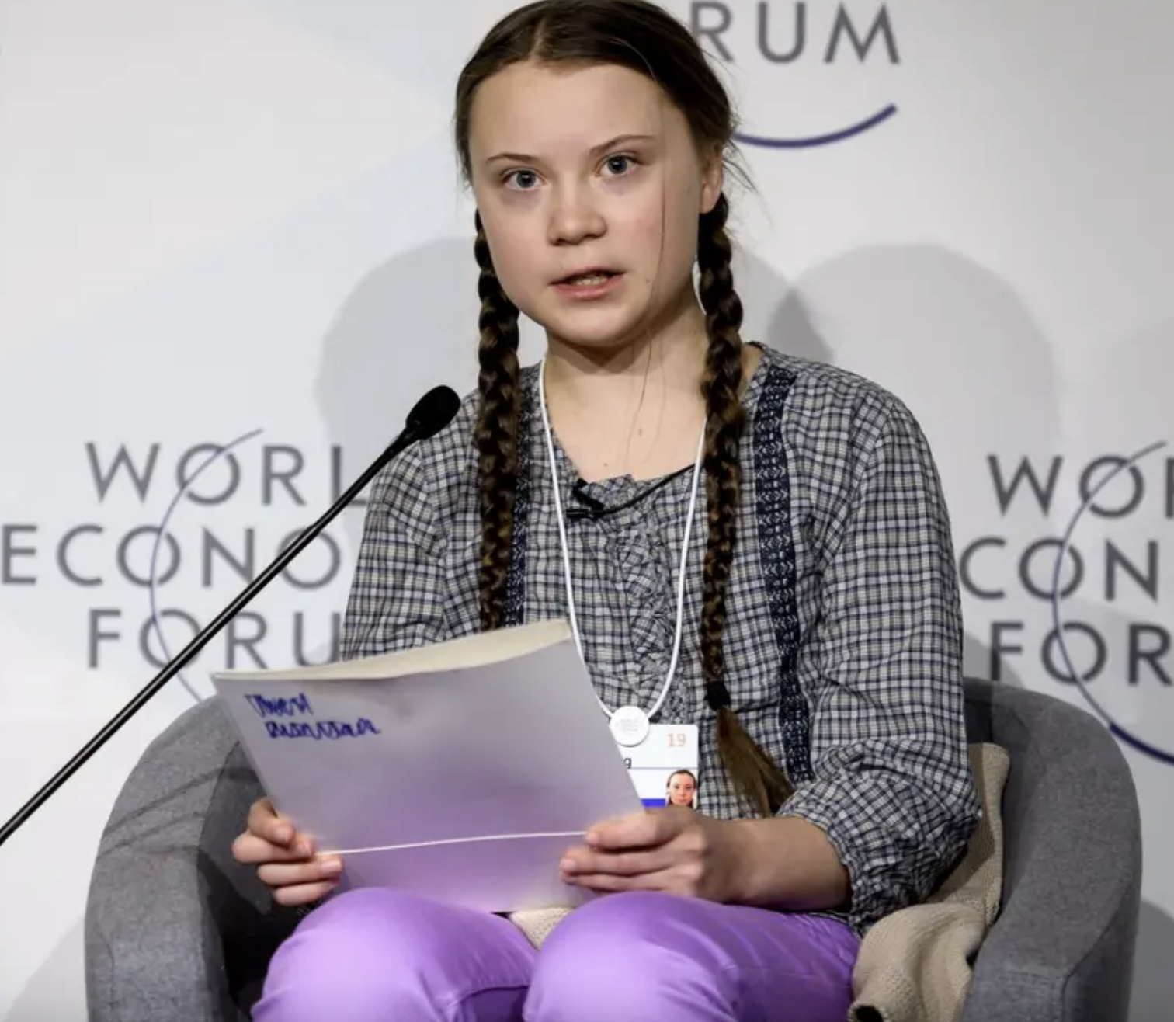
The Survival Drive in the Context of Sustainability
“I don’t want you to be hopeful. I want you to panic. I want you to feel the fear I feel every day. And then I want you to act. I want you to act as you would in a crisis. I want you to act as if the house was on fire—because it is.”
Greta Thunberg @ World Economic Forum, January 2019

Slide 14
Despair as Threat to the Drive to Survival

Slide 15
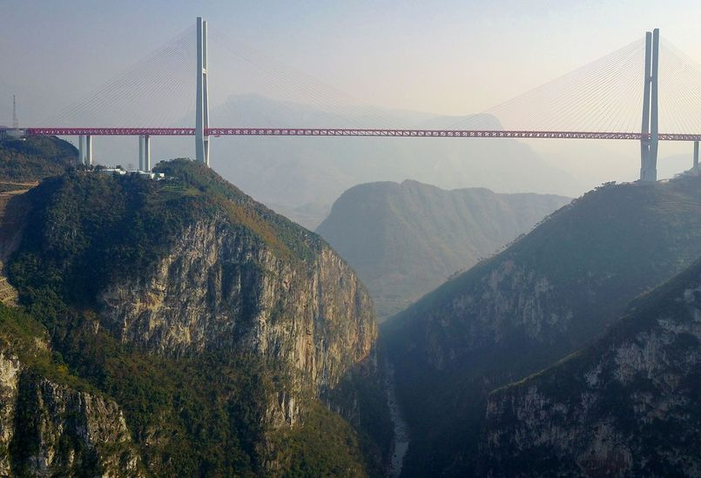
Drive 2: Mastery
“Science provides a powerful means of exercising the drive for exploration, mastery, and control over the environment. Humans have commanded space ships among the stars, plumbed the ocean depths, climbed Everest, and traversed both the North and South poles.”
Scioli and Biller, Hope in the Age of Anxiety, 91.
Example: Beipanjiang Bridge, China

Slide 16
The Mastery Drive in the Context of Sustainability

Slide 17
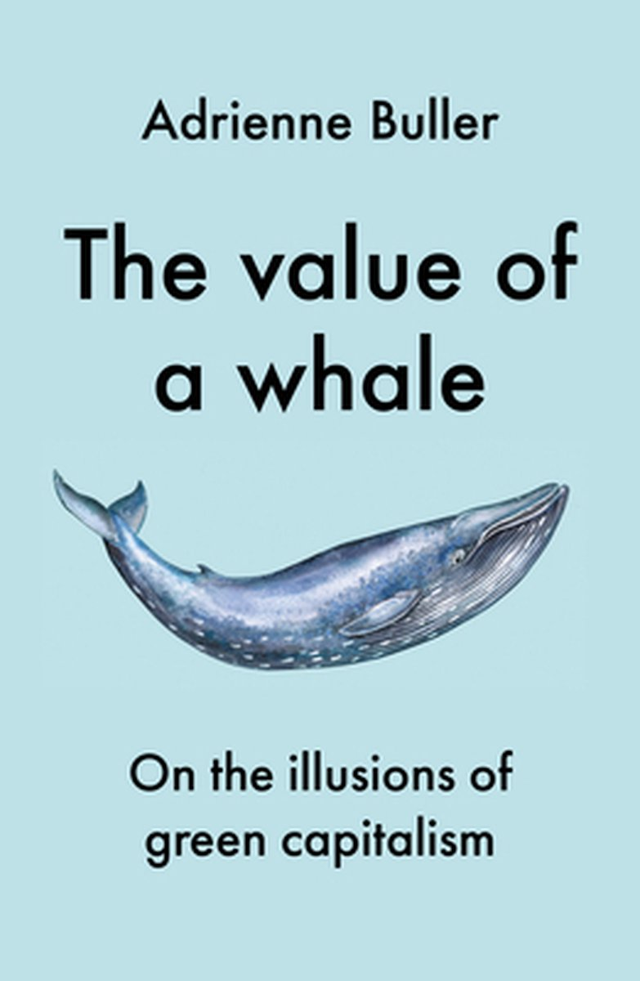
Challenges to the Mastery Drive in Sustainability

Slide 18
Drive 3: Relating
“Trust and openness, the products of positive attachments to others, are indispensable in the formation of hope.”
Scioli and Biller, Hope in the Age of Anxiety, 33.

Slide 19
The Importance of Relating in the Broad Spectrum of Political Ecology

Slide 20
The Findhorn Foundation on the Island Erraid
An Example

Slide 21
Challenges Pertaining to Relating
Small communities can have strong mechanisms of exclusion (Poland’s ‘LGBT-Free Zones’ as an example)
Therefore: need to listen to marginalized voices

Slide 22
Drive 4: Giving/Experiencing Meaning
This dimension entails “. . . that you believe your personal existence to be meaningful and that you have integrated your life experiences within a framework of values and principles.”
Scioli and Biller, Hope in the Age of Anxiety, 211.

Slide 23
Ecocentrism as New Meaning Paradigm
Leopold’s new ethical maxim: “A thing is right when it tends to preserve the integrity, stability, and beauty of the biotic community. It is wrong when it tends otherwise.”
Aldo Leopold, A Sand County Almanac and Sketches Here and There (Oxford: Oxford University Press, 1949), 262.

Slide 24
Anthropocentrism as Meaning Paradigm
Hans Jonas’ responsibility ethics as an example

Slide 25
Problems with the Meaning Drive
The supposed link between worldview and people’s behaviour has been under-researched
Huey-li Li, “On the Nature of Environmental Education,” The Philosophy of Educational Society Yearbook (1996): 256–263.
Japan as example

Slide 26
Summary
Anthropological choices play an important (but often unexplicated) role in the sustainability discourse
This discourse can benefit from a holistic approach, in which various drives are recognized in relation to each other

Slide 27
Room for Questions & Discussion
Is it indeed helpful to focus on anthropology, within the discourse of sustainability?
Do the four drives resonate with your understanding of human beings?

Slide 28
Group Work

Slide 29
Thank you!

